Slide 1
Project Management Probabilistic approach
Operations Management
by
R. Dan Reid & Nada R. Sanders
3th Edition © Wiley 2010

Slide 2
Network Planning Techniques
Program Evaluation & Review Technique (PERT):
Developed to manage the Polaris missile project
Many tasks pushed the boundaries of science & engineering (tasks’ duration = probabilistic)
Critical Path Method (CPM):
Developed to coordinate maintenance projects in the chemical industry
A complex undertaking, but individual tasks are routine (tasks’ duration = deterministic)

Slide 3
Both PERT and CPM
Graphically display the precedence relationships & sequence of activities
Estimate the project’s duration
Identify critical activities that cannot be delayed without delaying the project
Estimate the amount of slack associated with non-critical activities

Slide 4
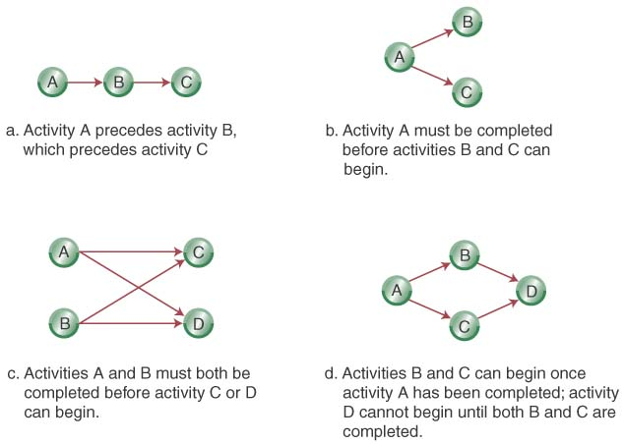
Network Diagrams
Activity-on-Node (AON):
Uses nodes to represent the activity
Uses arrows to represent precedence relationships

Slide 5
Step 1-Define the Project: Cables By Us is bringing a new product on line to be manufactured in their current facility in some existing space. The owners have identified 11 activities and their precedence relationships. Develop an AON for the project.

Slide 6
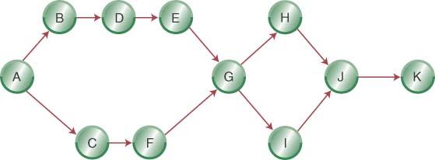
Step 2- Diagram the Network for Cables By Us

Slide 7
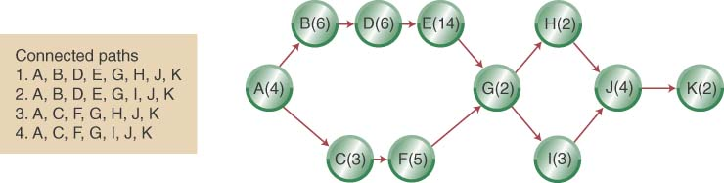
Step 3 (a)- Add Deterministic Time Estimates and Connected Paths

Slide 8
Step 3 (a) (Continued): Calculate the Path Completion Times
The longest path (ABDEGIJK) limits the project’s duration (project cannot finish in less time than its longest path)
ABDEGIJK is the project’s critical path

Slide 9
Program Evaluation and Review Technique

Slide 10
Estimation of Task Times
In CPM, we assume that the task durations are known with certainty.
This may not be realistic in many project settings.
How long does it take to design a switch?
PERT tries to account for the uncertainty in task durations.
Key question: What is the probability of completing project by given deadline?

Slide 11
CPM vs. PERT
CPM (critical path method)
PERT (program evaluation and review technique)
Both approaches work on a project network, which graphically portrays the activities of the project and their relationships.
CPM assumes that activity times are deterministic, while PERT views the time to complete a task as a random variable.

Slide 12
Estimation of the duration of project activities
(1) The deterministic approach (CPM), which ignores uncertainty thus results in a point estimate (e.g. The duration of task 1 = 23 hours, etc.)
(2) The stochastic approach (PERT), which considers the uncertain nature of project activities by estimating the expected duration of each activity and its corresponding variance.
To analyse the past data to construct the probabilistic distribution of a task.

Slide 13
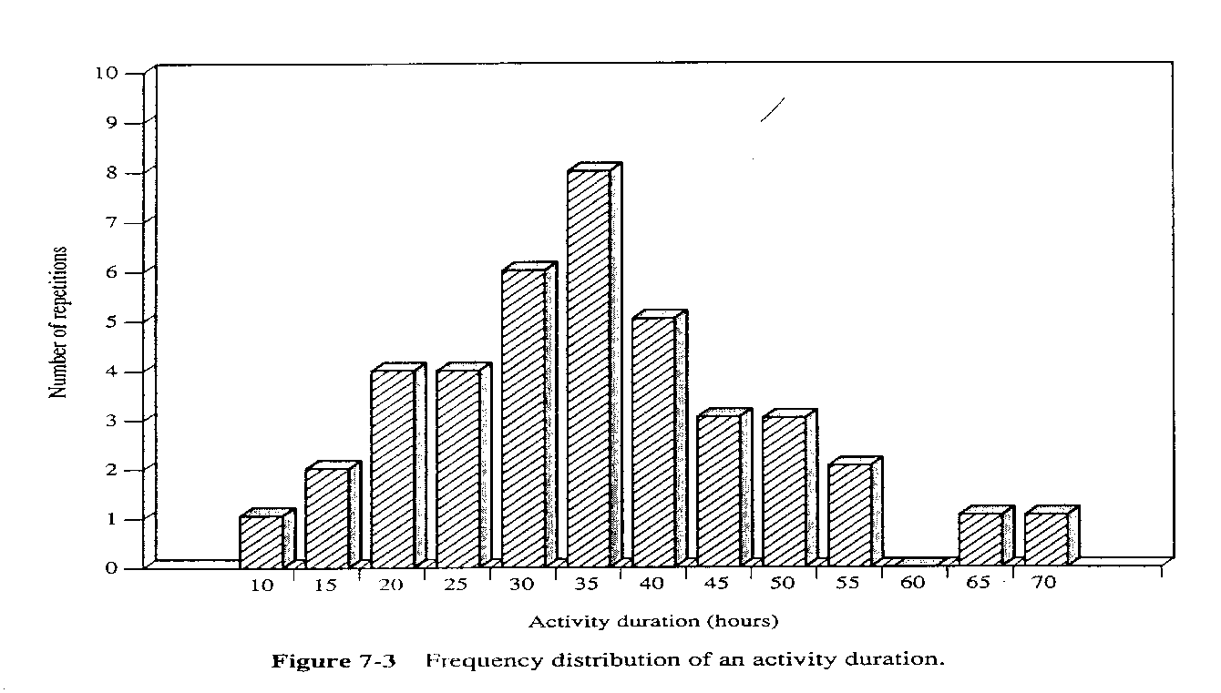
Estimation of the activity duration
Example: An activity was performed 40 times in the past, requiring a time between 10 to 70 hours. The figure below shows the frequency distribution.

Slide 14
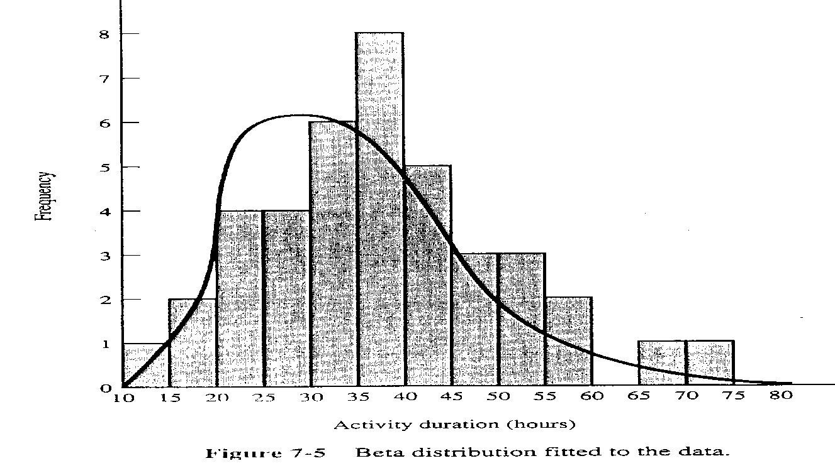
Estimation of the activity duration
The probability distribution of the activity is approximated by a probability frequency distribution.

Slide 15
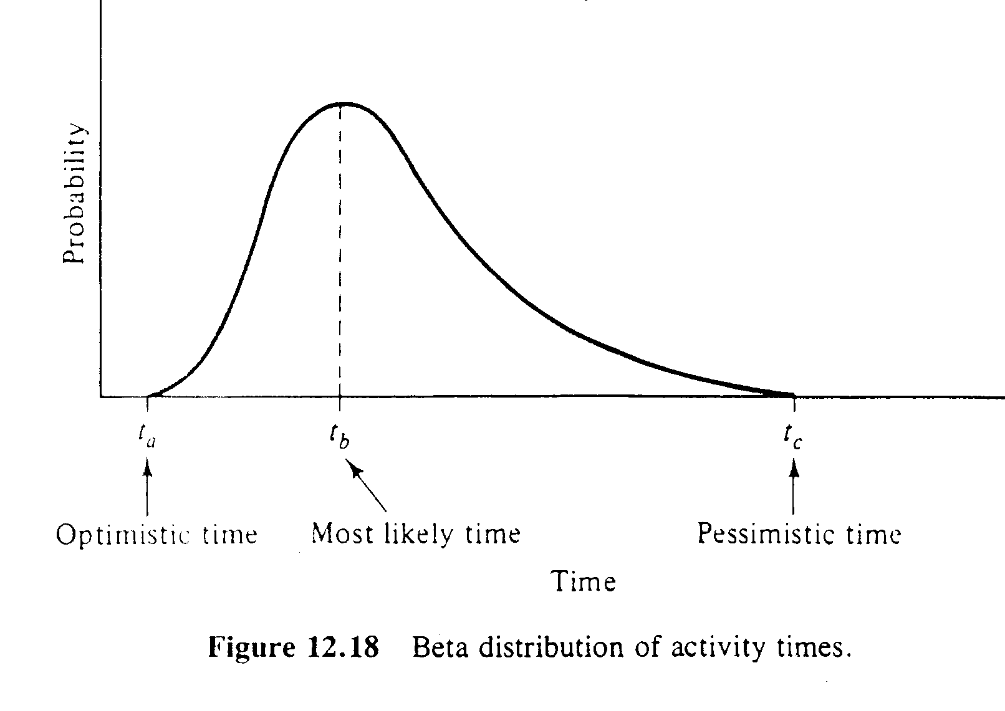
Estimation of the activity duration
In project scheduling, we usually use a beta distribution to represent the time needed for each activity.

Slide 16
Estimation of the activity duration
Three key values we use in the time estimate for each activity:
a = optimistic time, which means that there is little chance that the activity can be completed before this time;
m = most likely time, which will be required if the execution is normal;
b = pessimistic time, which means that there is little chance that the activity will take longer.

Slide 17
Estimation of Mean and SD
The expected or mean time is given by:
D= (a+4m+b)/6
The variance is:
V = (b-a) ²/36
The standard deviation is (b - a)/6
For our example (Figure 7-3), we have a=10, b=70, m=35.
Therefore D=36.6, and V² =100.

Slide 18
Estimation of Mean and SD
Beta-distribution
a
m
b
Expected task time:
Standard deviation:

Slide 19
The PERT Approach
The PERT (Program evaluation and review technique) approach addresses situations where uncertainties must be considered.

Slide 20
The PERT Approach (cont’d)
Now assume that the activity times are independent random variables.
Further, assume that there are n activities in the project, k of which are critical. Denote the activity times of the critical activities by the random variables d_{i} with mean E(d_{i}) and variances V(d_{i}), for i=1,2, …, k.
Then, the total project time (the total length of the critical path) is the random variable:
X= d₁ + d₂ +,…, +d_{k}

Slide 21
The PERT Approach (cont’d)
The mean project length, E(X), and its variance, V(X):
E(X)= E(d₁)+E(d₂)+,…, +E(d_{k})
V(X)= V(d₁)+V(d₂)+,…, +V(d_{k})
Assumption:
Activity times are independent random variables.
The project duration (=sum of times of activity on a critical path) is normally distributed.
Based on the Central Limit Theorem, which states that the distribution of the sum of independent random variables is approximately normal when the number of terms in the sum if sufficiently large.

Slide 22
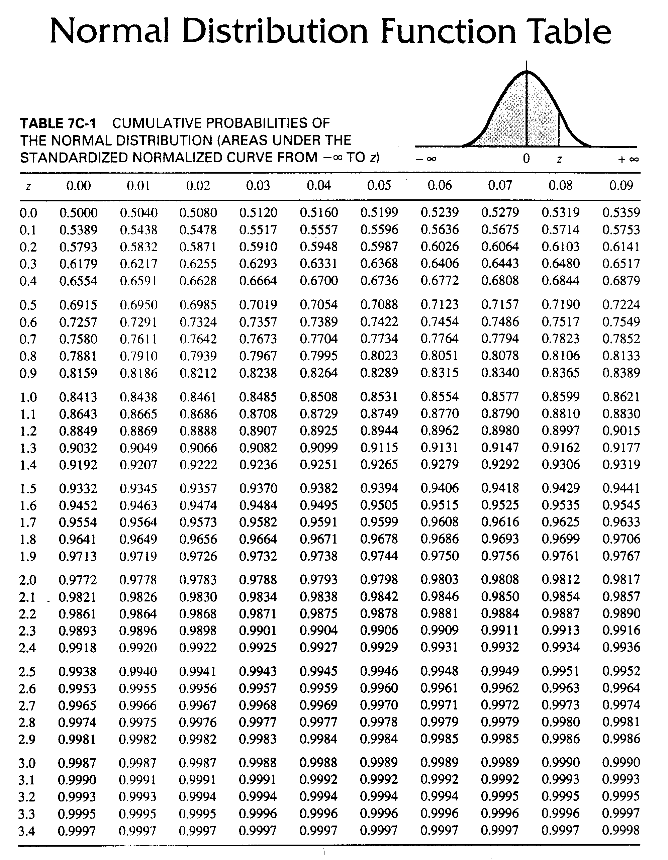

Slide 23
Example: Shopping Mall Renovation
Activity IP a m b
A: Prepare initial design - 1 3 5
B: Identify new potential clients - 4 5 12
C: Develop prospectus for tenants A 2 3 10
D: Prepare final design A 1 8 9
E: Obtain planning permission D 1 2 3
F: Obtain finance from bank E 1 3 5
G: Select contractor D 2 4 6
H: Construction G, F 10 17 18
I: Finalize tenant contracts B, C, E 6 13 14
J: Tenants move in I, H 1 2 3

Slide 24
Example: Issues to Address
Schedule the project.
2. What is the probability of completing the project in 36 weeks?

Slide 25
Expected Activity Time and SD
Act a m b t σ²
A 1 3 5 3 0.44
B 4 5 12 6 1.78
C 2 3 10 4 1.78
D 1 8 9 7 1.78
E 1 2 3 2 0.11
F 1 3 5 3 0.44
G 2 4 6 4 0.44
H 10 17 18 16 1.78
I 6 13 14 12 1.78
J 1 2 3 2 0.11

Slide 26
CPM with Expected Activity Times
I,12
B,6
J,2
End
1
E,2
C,4
F,3
A,3
D,7
G,4
H,16

Slide 27
Critical Path and Expected Time
Critical path: A-D-E-F-H-J.
Expected Completion time: 33 weeks
What is the probability to complete the project within 36 weeks?
-- Use the critical path to assess the probability

Slide 28
Probability Assessment
Expected project completion time:
Sum of the expected activity times
along the critical path.
Used to obtain
probability of project
completion
μ = 3+7+2+3+16+2 = 33
Variance of project-completion time
Sum of the variances along
the critical path.
σ² = 0.44+1.78+0.11+0.44+1.78+0.11= 4.66
σ = 2.15

Slide 29
Assessment by Normal Distribution
P(X ≤ 36) = ?
P(Z ≤ 1.4) = ?
Assume X ~ N(33, 2.15²)
T
-
μ
36
-
33
z
=
=
=
1.4
.
σ
2.15
Normal Distribution
Standardized Normal Distribution
σ
= 2.15
σ
= 1
z
μ
= 33
36
X
μ
= 0
1.4
Z
z

Slide 30
Obtain the Probability
Standardized Normal Probability Table (Portion)
Z
.00
.01
.02
P(Z<1.4) = 0.9192
σ_{z}=1
0.0
.5000
.5040
.5080
:
:
:
:
1.4
.9192
.9207
.9222
.9192
μ_{z}=0
1.4
z
1.5
.9332
.9345
.9357
P( 0 < Z < z )

Slide 31
Completion Time with a Given Prob.
Using PERT, it is also possible to estimate the completion time for a desired completion probability.
For example, for a 95% probability the corresponding Z value is Z_{0.95} = 1.64. Solving for the time T for which the probability to complete the project is 95%, we get
Z_{0.95} = (T – 33)/2.15 = 1.64
T = 33 + (2.15)(1.64) = 36.5

Slide 32
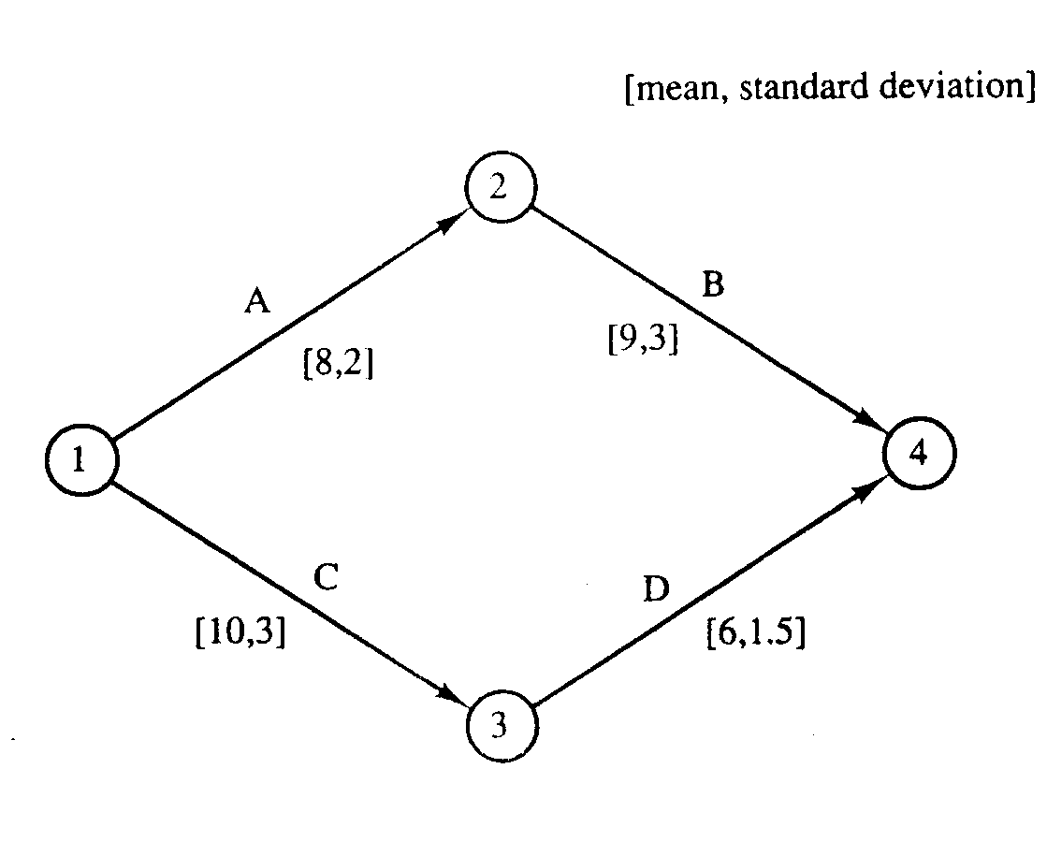
A Shortcoming of Standard PERT
The standard PERT method ignores all activities not on the critical path.
What is the probability to complete the project within 17 weeks?

Slide 33
A Modification
Identify each sequence of activities leading from the start to the end, and then calculate separately the probability for each path to complete by a given date.
The above can be done by assuming that the central limit theorem holds for each sequence and then applying normal distribution theory to calculate the individual sequence (path) probabilities.
Assume, if necessary, that the paths are statistically independent (i.e. the time to traverse each path in the network is independent of what happens on the other paths).
Although this additional assumption is rarely true in practice, empirical evidence suggests that good results can be obtained.

Slide 34
Modified Probability of Completion
Once the calculations on all paths (at least those that we are concerned with) are performed, the probability of completing the whole project can be calculated.
Assume there are n paths, with completion times X₁, X₂, …, X_{n}. Then, the probability of completing the project is
P(X ≤ T) = P(X₁ ≤ T) P(X₂ ≤ T) … P(X_{n} ≤ T)

Slide 35
Example: Modified Calculations
If no uncertainty exists, then the critical path is (A-B) and exactly 17 weeks are required to finish the project.
If the durations of the four activities are normally distributed (the means and variances are as shown in the figure above), then the durations of the two paths are normally distributed as follows:
length (A-B) = X₁ ~ N(17, 3.61)
length (C-D) = X₂ ~ N(16, 3.35)

Slide 36
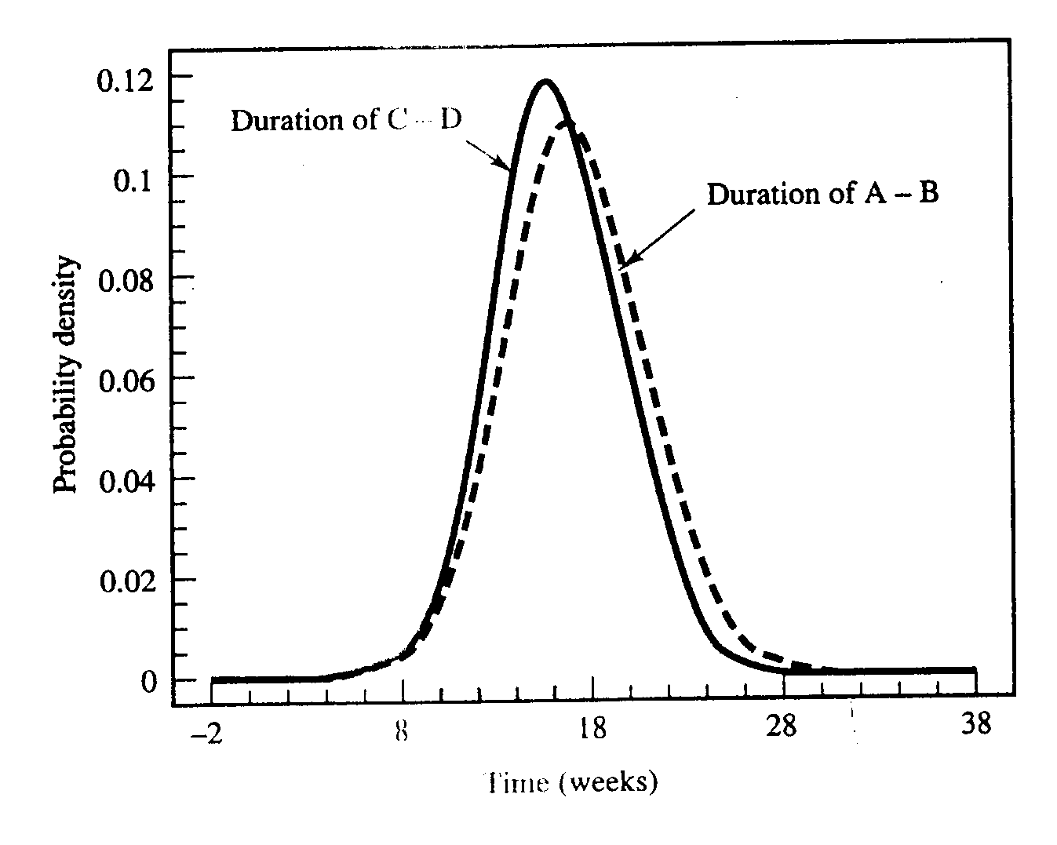
The Probability Density Functions

Slide 37
Project Completion Probabilities
The project can be completed in 17 weeks only if both (A-B) and (C-D) are completed within that time. The probabilities for the two paths to be completed in that time are given below:
17-17
P(X₁ ≤ 17) = P(Z ≤ ----------- ) = P(Z ≤ 0)=0.5
3.61
17-16
P(X₂ ≤ 17) = P(Z ≤ ----------- ) = P(Z ≤ 0.299)=0.62
3.35
Thus, the probability of completing the project within 17 weeks is
P(X ≤ 17) = P(X₁ ≤ 17) P(X₂ ≤ 17) = (0.5)(0.62)=0.31 = 31 %.

Slide 38
Revisiting Cables By Us Using Probabilistic Time Estimates

Slide 39
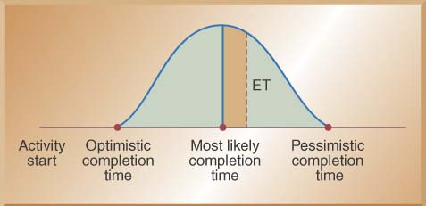
Using Beta Probability Distribution to Calculate Expected Time Durations
A typical beta distribution is shown below, note that it has definite end points
The expected time for finishing each activity is a weighted average

Slide 40
Calculating Expected Task Times

Slide 41
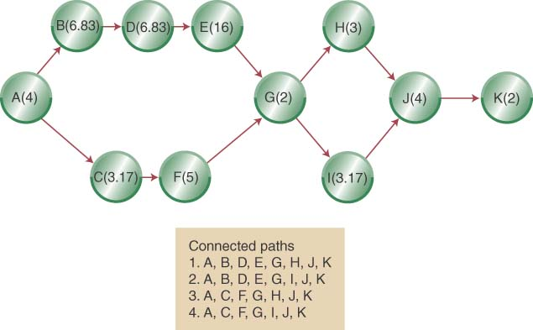
Network Diagram with Expected Activity Times

Slide 42
Estimated Path Durations through the Network
ABDEGIJK is the expected critical path & the project has an expected duration of 44.83 weeks

Slide 43
Estimating the Probability of Completion Dates
Using probabilistic time estimates offers the advantage of predicting the probability of project completion dates
We have already calculated the expected time for each activity by making three time estimates
Now we need to calculate the variance for each activity
The variance of the beta probability distribution is:
where p=pessimistic activity time estimate
o=optimistic activity time estimate

Slide 44
Project Activity Variances
Activity | Optimistic | Most Likely | Pessimistic | Variance
A | 2 | 4 | 6 | 0.44
B | 3 | 7 | 10 | 1.36
C | 2 | 3 | 5 | 0.25
D | 4 | 7 | 9 | 0.69
E | 12 | 16 | 20 | 1.78
F | 2 | 5 | 8 | 1.00
G | 2 | 2 | 2 | 0.00
H | 2 | 3 | 4 | 0.11
I | 2 | 3 | 5 | 0.25
J | 2 | 4 | 6 | 0.44
K | 2 | 2 | 2 | 0.00

Slide 45
Critical Activity Variances
Activity | Optimistic | Most Likely | Pessimistic | Variance
A | 2 | 4 | 6 | 0.44
B | 3 | 7 | 10 | 1.36
C | 2 | 3 | 5 | 0.25
D | 4 | 7 | 9 | 0.69
E | 12 | 16 | 20 | 1.78
F | 2 | 5 | 8 | 1.00
G | 2 | 2 | 2 | 0.00
H | 2 | 3 | 4 | 0.11
I | 2 | 3 | 5 | 0.25
J | 2 | 4 | 6 | 0.44
K | 2 | 2 | 2 | 0.00
Critical activities highlighted
Sum over critical = 4.96

Slide 46
Calculating the Probability of Completing the Project in Less Than a Specified Time
When you know:
The expected completion time EF_{P}
Its variance σ_{Path}²
You can calculate the probability of completing the project in “D_{T}” weeks with the following formula:
Where D_{T} = the specified completion date
EFPath = the expected completion time of the path

Slide 47
Apply z formula to critical path
Use Standard Normal Table (Appendix B) to answer probabilistic questions, such as
Question 1: What is the probability of completing project (along critical path) within 48 weeks?

Slide 48
Probability of completion by D_{T}
Area = .4222
Probability = .4222+ .5000 =.9222 or 92.22%
Project not finished
by the given date
Tail Area = .0778
Area left of y-axis = .50
0
Z₉₂ = 1.42
z

Slide 49
Apply z formula to critical path
Use Standard Normal Table (Appendix B) to answer probabilistic questions, such as
Question 2: By how many weeks are we 95% sure of completing project (along critical path)?

Slide 50
Probability Question 2
Area = .45
D_{T} = 48.5 weeks
Tail Area = .05
Area left of y-axis = .50
0
Z₉₅ = 1.645
z

Slide 51
Reducing Project Completion Time
Project completion times may need to be shortened because
Different deadlines
Penalty clauses
Need to put resources on a new project
Promised completion dates
Reduced project completion time is “crashing”

Slide 52
Reducing Project Completion Time - continued
Crashing a project needs to balance
Shorten a project duration
Cost to shorten the project duration
Crashing a project requires you to know
Crash time of each activity
Crash cost of each activity

Slide 53
The Critical Chain Approach
The Critical Chain Approach focuses on the project due date rather than on individual activities and the following realities:
Project time estimates are uncertain so we add safety time
Multi-levels of organization may add additional time to be “safe”
Individual activity buffers may be wasted on lower-priority activities
A better approach is to place the project safety buffer at the end
Original critical path
Activity A |  | Activity B |  | Activity C |  |  | Activity D |  | Activity E
Critical path with project buffer
Activity A | Activity B |  | Activity C |  | Activity D | Activity E |  | Project Buffer

Slide 54
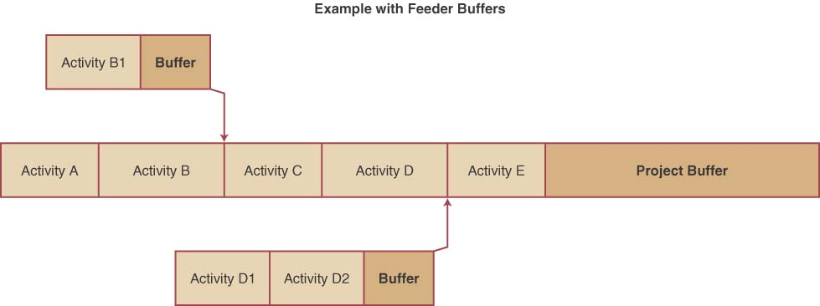
Adding Feeder Buffers to Critical Chains
The theory of constraints, the basis for critical chains, focuses on keeping bottlenecks busy.
Time buffers can be put between bottlenecks in the critical path
These feeder buffers protect the critical path from delays in non-critical paths

Slide 55
Approaches to Project Implementation
Pure Project
Functional Project
Matrix Project

Slide 56
Advantages
A PURE PROJECT is where a self-contained team works full-time on the project
The project manager has full authority over the project
Team members report to one boss
Shortened communication lines
Team pride, motivation, and commitment are high
Source: Chase, Jacobs & Aquilano, Operations Management 11/e
Notes:
8

Slide 57
Pure Project: Disadvantages
Duplication of resources
Organizational goals and policies are ignored
Lack of technology transfer
Team members have no functional area "home"
Source: Chase, Jacobs & Aquilano, Operations Management 11/e
Notes:
8

Slide 58
Functional Project
housed within a functional division
President
Research and
Development
Engineering
Manufacturing
Project
A
Project
B
Project
C
Project
D
Project
E
Project
F
Project
G
Project
H
Project
I
Example, Project “B” is in the functional area of Research and Development.
Source: Chase, Jacobs & Aquilano, Operations Management 11/e
Notes:
9

Slide 59
Functional Project: Advantages
A team member can work on several projects
Technical expertise is maintained within the functional area
The functional area is a “home” after the project is completed
Critical mass of specialized knowledge
Source: Chase, Jacobs & Aquilano, Operations Management 11/e
Notes:
10

Slide 60
Functional Project: Disadvantages
Aspects of the project that are not directly related to the functional area get short-changed
Motivation of team members is often weak
Needs of the client are secondary and are responded to slowly
Source: Chase, Jacobs & Aquilano, Operations Management 11/e
Notes:
11

Slide 61
Matrix Project: combines features of pure and functional
President
Research and
Development
Engineering
Manufacturing
Marketing
Manager
Project A
Manager
Project B
Manager
Project C
Source: Chase, Jacobs & Aquilano, Operations Management 11/e
Notes:
12

Slide 62
Matrix Project: Advantages
Enhanced communications between functional areas
Pinpointed responsibility
Duplication of resources is minimized
Functional “home” for team members
Policies of the parent organization are followed
Source: Chase, Jacobs & Aquilano, Operations Management 11/e
Notes:
13

Slide 63
Matrix Project: Disadvantages
Too many bosses
Depends on project manager’s negotiating skills
Potential for sub-optimization
Source: Chase, Jacobs & Aquilano, Operations Management 11/e
Notes:
14

Slide 64
Additional Example
Note: activity “0” is a formality.
Source: Chase, Jacobs & Aquilano, Operations Management 11/e

Slide 65
Additional Example
Note: activity “0” is a formality.
Source: Chase, Jacobs & Aquilano, Operations Management 11/e

Slide 66
Additional Example, continued
C
A
2
F
3
4
D
0
H
3
3.83
paths
0ACFH
0ADFH
0ADGH
0BEGH
G
B
2
3.83
E
5

Slide 67
Additional Example, continued
C
A
2
F
3
4
D
0
H
3
3.83
G
B
2
3.83
E
Critical Path: 0-B-E-G-H
Length = 14.67
5

Slide 68
Additional Example, continued.
Add variances along path
to get path variance
C
1.83
F
A
.83
.83
D
0
H
.83
0.25
0.11
0
1.78
G
B
0.69
0
0
total=2.83
E
0

Slide 69
Probabilistic Analysis
Additional Example, continued.
Project completion times assumed normally distributed with mean 14.67 and variance 2.83
Z-score
From table look-up, P(D_{T}≤16) = .7549
14.67
16
Find the probability of completing the project within 16 days.

Slide 70
Probabilistic Analysis
Additional Example, continued.
Project completion times assumed normally distributed with mean 14.67 and variance 2.83
Z₉₅ = 1.645, thus
Solving for X=17.44 days
14.67
17.44
Find the 95-th percentile of project completion.

Slide 71
Example 2, #13-14 Ch 16:

Slide 72
Example 2, #13-14 Ch 16:

Slide 73
Example 2, #13-14 Ch 16:
B(10)
D(8)
F(7.17)
A(10)
H(3)
C(5)
E(7.33)
G(8)

Slide 74
Example 2, #13-14 Ch 16: PATH 1
B(10)
D(8)
F(7.17)
A(10)
H(3)
Length = 38.17

Slide 75
Example 2, #13-14 Ch 16: PATH 2
Length = 33.33
A(10)
H(3)
C(5)
E(7.33)
G(8)

Slide 76
Example 2, #13-14 Ch 16: PATH 3
B(10)
D(8)
A(10)
H(3)
Length = 39
G(8)

Slide 77
Example 2, #13-14 Ch 16: PATH 4
F(7.17)
Length = 32.5
A(10)
H(3)
C(5)
E(7.33)

Slide 78
Example 2, #13-14 Ch 16: CRITICAL PATH
B(10)
D(8)
A(10)
H(3)
Length = 39
Path variance = 6.67
G(8)

Slide 79
Apply z formula to critical path
Use Standard Normal Table (Appendix B) to answer probabilistic questions, such as
Question 1: What is the probability of completing project (along critical path) within 36 weeks?

Slide 80
Probability of completion by D_{T}
Area left of y-axis = .50
Area = .3770
Probability =
.5000 - 3770
=.1230 or 12.3%
Project finished
by the given date
Tail Area = .1230
0
z
Z = -1.16

Slide 81
Apply z formula to critical path
Use Standard Normal Table (Appendix B) to answer probabilistic questions, such as
Question 2: What is the probability of completing project (along critical path) within 40 weeks?
Probability = .6517 = 65.17%
Question 3: By how many weeks are we 99% sure of completing project (along critical path)?
DT = 45.02 weeks

Slide 82
Example 3, #4-8 Ch 16:

Slide 83
Example 3, #4-#8 Ch 16:
B(5)
D(7.67)
F(4)
H(6.5)
A(6)
J(3)
C(7.33)
G(5.83)
I(8)
E(10.17)

Slide 84
Example 3, #4-#8 Ch 16:
B(5)
D(7.67)
F(4)
H(6.5)
A(6)
J(3)
C(7.33)
G(5.83)
I(8)
E(10.17)
length =32.17

Slide 85
Example 3, #4-#8 Ch 16:
B(5)
D(7.67)
F(4)
H(6.5)
A(6)
J(3)
C(7.33)
G(5.83)
I(8)
E(10.17)
length = 35.50

Slide 86
Example 3, #4-#8 Ch 16:
B(5)
D(7.67)
F(4)
H(6.5)
A(6)
J(3)
C(7.33)
G(5.83)
I(8)
E(10.17)
length =37

Slide 87
Example 3, #4-#8 Ch 16:
B(5)
D(7.67)
F(4)
H(6.5)
A(6)
J(3)
C(7.33)
G(5.83)
I(8)
E(10.17)
length = 40.33 CRITICAL PATH

Slide 88
Example 3, #4-#8 Ch 16:
B(5)
D(7.67)
F(4)
H(6.5)
A(6)
J(3)
C(7.33)
G(5.83)
I(8)
E(10.17)
Path variance =1+1.78+3.36+0.69+1+0 = 7.83

Slide 89
Apply z formula to critical path
Use Standard Normal Table (Appendix B) to answer probabilistic questions, such as
Question 1: What is the probability of completing project (along critical path) within 38 weeks?

Slide 90
Probability of completion by D_{T}=38
Area left of y-axis = .50
Area = .2967
Probability =
.5000 - 2967
=.2033 or 20.33%
Project finished
by the given date
Tail Area = .2033
0
z
Z = -0.83

Slide 91
Apply z formula to critical path
Use Standard Normal Table (Appendix B) to answer probabilistic questions, such as
Question 2: What is the probability of completing project (along critical path) within 42 weeks?
Probability = .2257+.5000 = .7257 = 72.57%

Slide 92
Apply z formula to critical path
Use Standard Normal Table (Appendix B) to answer probabilistic questions, such as
Question 3: By how many weeks are we 99% sure of completing project (along critical path)?
DT = 46.85 weeks

